Slide 1
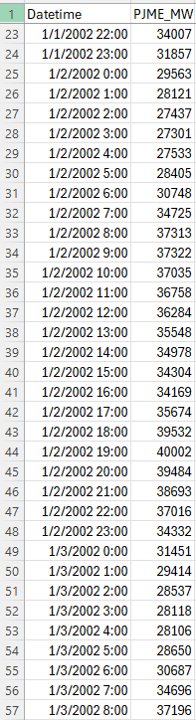
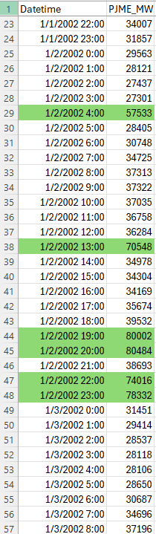
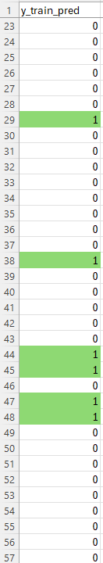
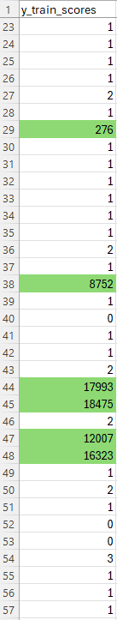
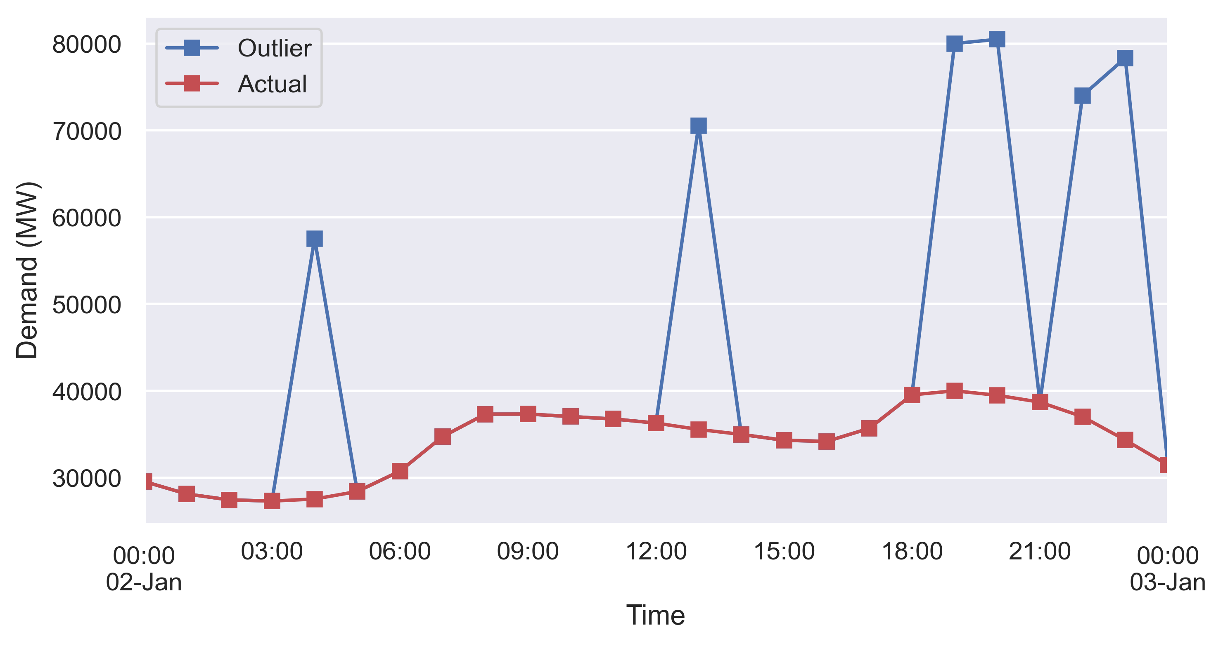
Outlier Detection (PyOD-KNN):
Original data
Data with outliers
Outlier detection results
This PyOD-KNN is only designed for 2-dimensional data. PyOD-TODS is a better choice for outlier detection on multivariate time-series data. However, I can not install it due to errors. So, I tried other outlier detection packages.
Manually added outliers

Slide 2
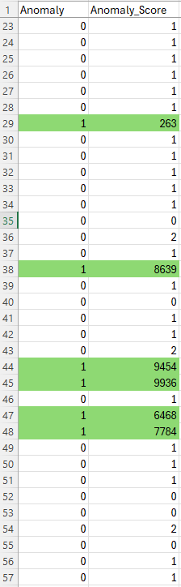
Outlier Detection (PyCaret-KNN):
Original data
Data with outliers
Outlier detection results
Manually added outliers

Slide 3
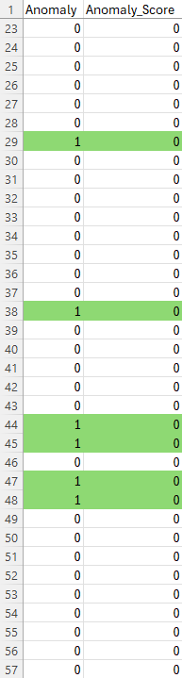
Outlier Detection (PyCaret-iforest):
Original data
Data with outliers
Outlier detection results
Manually added outliers

